Slide 1
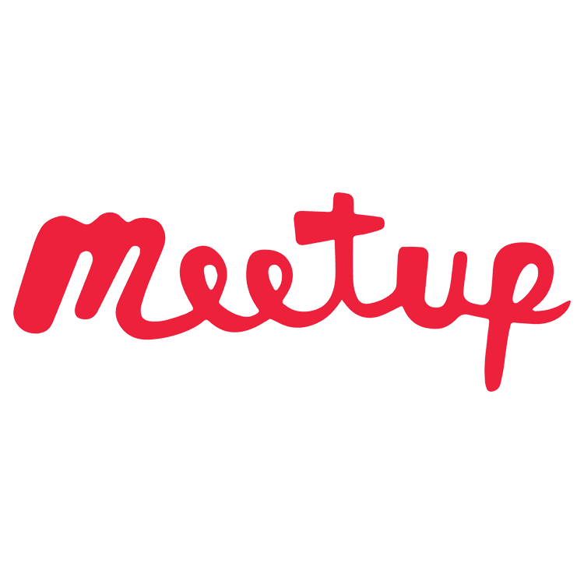
Intro to Docker -> Kubernetes -> Helm
Craiova Software and Technology Meetup,
December 2019

Slide 2
Outline
Docker
Docker examples
Kubernetes
Kubernetes examples
Helm
Helm examples
Resources

Slide 3

Docker key features
Do you know the famous phrase It works on my machine?
Docker is a computer program that performs operating-system-level virtualization, also known as “containerization”.
easier to build, deploy and run applications using containers
containers allow us to package all libraries and other dependencies and ship as a single package
application can be run on any machine and have the same behaviour.
Notes:
Example: application made for Tomcat, then need to run on multiple servers.

Slide 4
Docker Hello World!
Install Docker
(https://docs.docker.com/docker-for-windows/install/)
Run a hello-world image:
$ docker run hello-world
Create a docker image file
Build docker image from file
$ docker build -t flask-app:0.1 .
Run docker container from image
$ docker run -d -p 5000:5000 flask-app:0.1
App.py
from flask import Flask
app = Flask(__name__)
@app.route("/")
def hello():
return "Hello World!"
if __name__ == "__main__":
app.run(debug=True, host="0.0.0.0")
Dockerfile
# Inherit from the Python Docker image FROM python:3.7-slim # Install the Flask package via pip RUN pip install flask==1.0.2 # Copy the source code to app folder COPY ./app.py /app/ # Change the working directory WORKDIR /app/ # Set "python" as the entry point ENTRYPOINT ["python"] # Set the command as the script name CMD ["app.py"]

Slide 5
Docker commands
Docker ps –a
Docker stop {container_id_or_name}
Docker rm {container_id_or_name}
Docker images
Docker rmi {image_id_or_name}
Docker logs -f {container_id_or_name}
docker exec -it {container_id_or_name} bash

Slide 6
Kubernetes key features
Automates various manual processes: controls which server will host the container, how it will be launched etc.
Interacts with several groups of containers
Provides additional services: management of containers, security, networking and storage services
Self-monitoring: checks constantly the health of nodes and containers
Horizontal scaling: scale resources not only vertically but also horizontally, easily and quickly
Storage orchestration: mounts and add storage system of your choice to run apps

Slide 7
Kubernetes key features
Automates rollouts and rollbacks: if after a change to your application something goes wrong, Kubernetes will rollback for you
Container balancing: Kubernetes always knows where to place containers, by calculating the “best location” for them
Run everywhere: Kubernetes is an open source tool and gives you the freedom to take advantage of on-premises, hybrid, or public cloud infrastructure, letting you move workloads to anywhere you want
https://kubernetes.io/docs/tutorials/kubernetes-basics/create-cluster/cluster-intro/

Slide 8
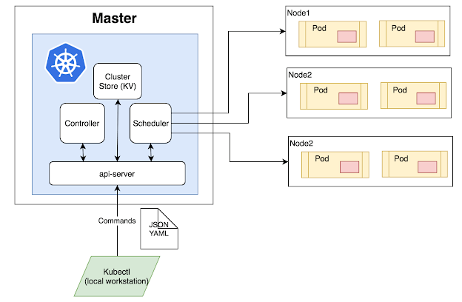
Kubernetes cluster structure

Slide 9
Kubernetes Hello World
Install Kubernetes (https://docs.docker.com/docker-for-windows/#kubernetes)
Deploy an image
kubectl create deployment kube-hello --image=flask-app:0.1
Expose the container through a service
kubectl expose deployment/kube-hello --type="NodePort" --port 5000
Scale the application
kubectl scale deployments/kube-hello --replicas=2
Notes:
kubectl config get-contexts - see kubectl clusters
kubectl get deployments - to check the number of pods before scaling
kubectl get pods -o wide - see the IPs of the pods
kubectl logs - check logs for pods between requests to see load balancing

Slide 10
Kubernetes commands
kubectl get - list resources (deployments, nodes, pods)
kubectl describe - show detailed information about a resource
kubectl logs - print the logs from a container in a pod
kubectl exec - execute a command on a container in a pod
The cheatsheet:
https://kubernetes.io/docs/reference/kubectl/cheatsheet/

Slide 11
Helm key features
Manage Complexity - define, install, and upgrade even the most complex Kubernetes application
Simple Sharing - Charts are easy to create, version, share, and publish
Easy Updates
Rollbacks - helm rollback

Slide 12
Helm description
Package manager - bundle files for an application(config-map.yaml, deployment.yaml, service.yaml)
Create templates combined with values from file (values.yaml) or runtime
Install, update or delete charts
Install same chart with multiple values at runtime creates multiple releases
Simple use of community charts (install Nexus)
Manage your application (microservices)

Slide 13
Helm examples
Install Helm (https://helm.sh/docs/using_helm/#installing-helm)
First install the local client, then the server part (tiller) by running: helm init
Create a sample chart
helm create hello-chart
Install chart
helm install hello-release hello-chart
Upgrade chart (upgrade the version first)
helm upgrade --version 0.1.1 hello-release hello-chart
Delete chart
helm delete hello-release
Notes:
Helm ls – list releasese

Slide 14
Q & A

Slide 15
Resources
https://medium.com/@kelvin_sp/docker-introduction-what-you-need-to-know-to-start-creating-containers-8ffaf064930a
https://kubernetes.io/docs/tutorials/kubernetes-basics/create-cluster/cluster-intro/
https://helm.sh/docs/using_helm/#quickstart

